Slide 1
Prestigio Solutions
Multiboards Practical Cases

Slide 2
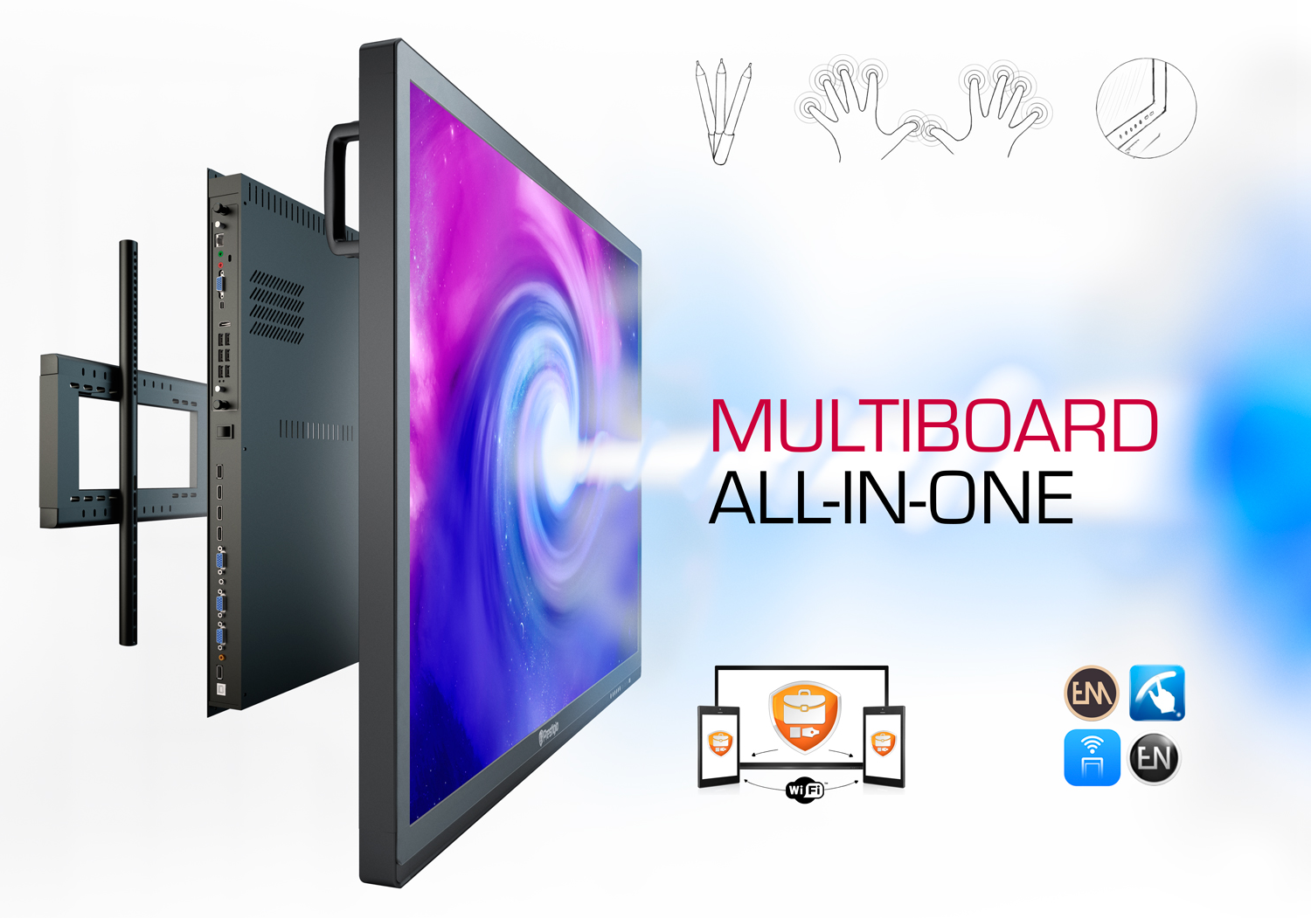




Interactive Screen LineUp with integrated Windows PC,
also Windows OS
& special Applications
Our Multiboards were specially created to increase the opportunities & options in EDU, Business channels & Meeting Rooms
UHD-screen
Seven styluses
Protected case with aluminum & protected glass
20points Touch
Wall Mount kit
(optionally)
Integrated Apps to control the Multiboard &/or connect devices
Special Apps for EDU, Business & Collaboration

Slide 3
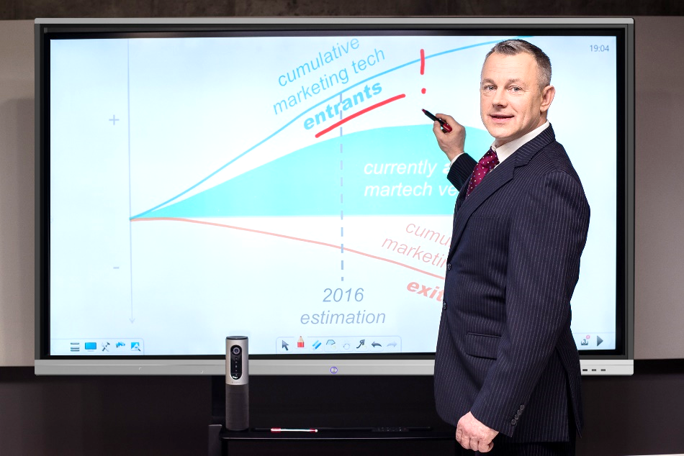




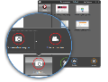
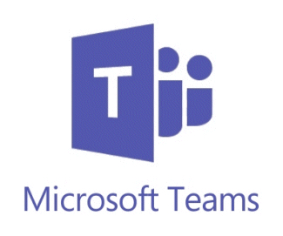


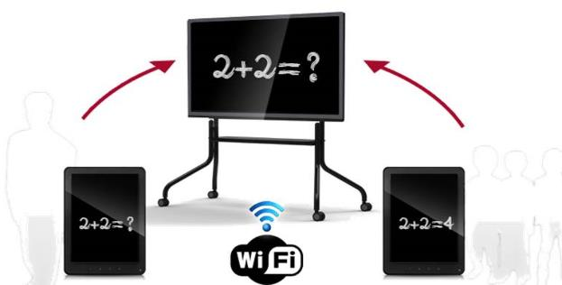





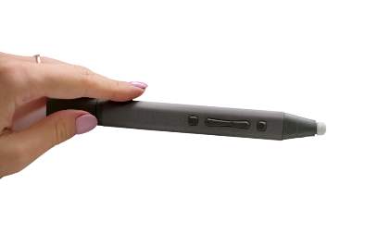

Windows 10 PC for Group Collaboration
Easy use of widely known Windows 10 Pro interface
Evolve technology with 700K+ apps from Microsoft Store
Converge video, text, internet, audio in one device
Share device, share content, control devices & content, record
COLABORATE
PRESENT
EDUCATE
*compatible with Apps for collaboration

Slide 4
Prestigio Solutions MB LineUp, 2022’H1
65”
PMB000L654 (Light Series)
UHD / Android 8.0 / 20 points multitouch / ARM A73+A53, 3GB, 32GB / PC Windows (optionally)
75”
PMB000L754 (Light Series)
UHD / Android 8.0 / 20 points multitouch / ARM A73+A53, 3GB, 32GB / PC Windows (optionally)
86”
PMB000L864 (Light Series)
UHD / Android 8.0 / 20 points multitouch / ARM A73+A53, 3GB, 32GB / PC Windows (optionally)
65”
PMB528L653 (Prime Series)
UHD, Windows 10 Pro / Android 9.0 / 20 points multitouch / Intel® Core™ i5 10th Gen, 8GB, 256GB / Independent Graphic Card
75”
PMB728L753 (Prime Series)
UHD, Windows 10 Pro / Android 9.0 / 20 points multitouch / Intel® Core™ i7 10th Gen, 8GB, 256GB / Independent Graphic Card
86”
PMB728L863 (Prime Series)
UHD, Windows 10 Pro / Android 9.0 / 20 points multitouch / Intel® Core™ i7 10th Gen, 8GB, 256GB / Independent Graphic Card
98”
PMB751G983 (Prime Series)
UHD, Windows 10 Pro / Android 8.0 / 20 points touch / Intel® Core™ i7 8th Gen, 16GB, 512GB / Independent Graphic Card
PC
PMB528K001 (PC for Light Series models) EOL
PC 80 pin / with Intel® Comet Lake-U CPU i5 10210U 10th Gen / 8GB / 256GB
PC
PMB528K002 (PC for Light Series models)
PC 80 pin / with Intel® Comet Lake-U CPU i5 10210U 10th Gen / 8GB / 256GB, 3G & LTE module

Slide 5

Practical Cases

Slide 6
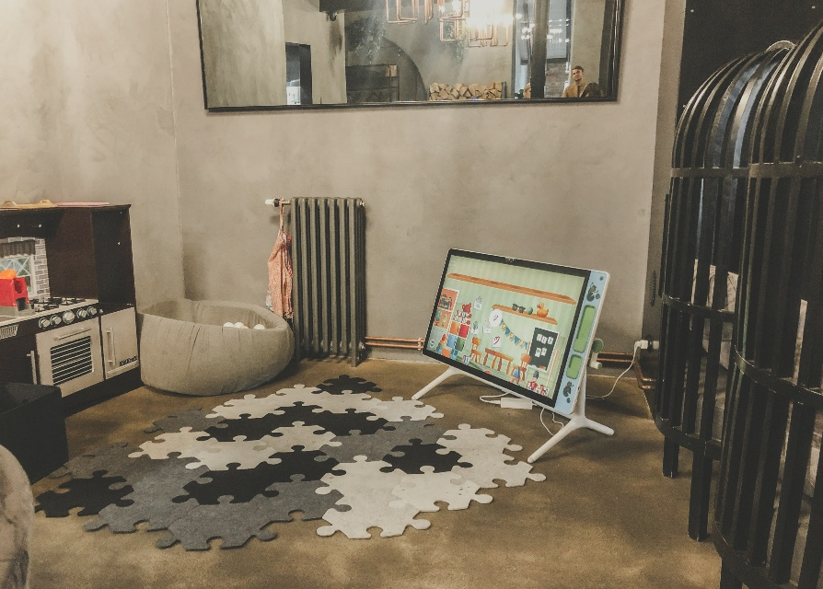
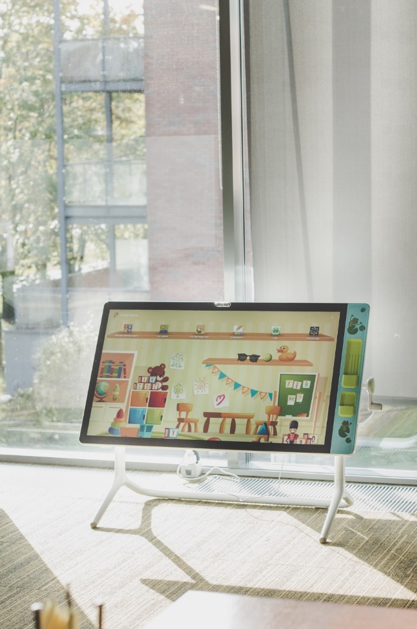
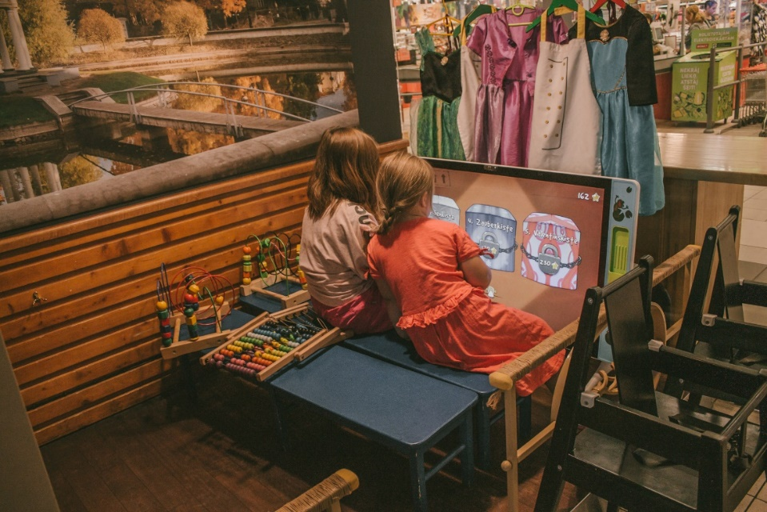
Latvia
Solution: 43” Multiboard (3 units)
Client: Cili Pizza chain
Business need: kids zone in a restaurant
Sales channel: via partner
Decision maker: owner of the restaurant (BEU)
Client’s feedback: very nice solution for a kids corner

Slide 7
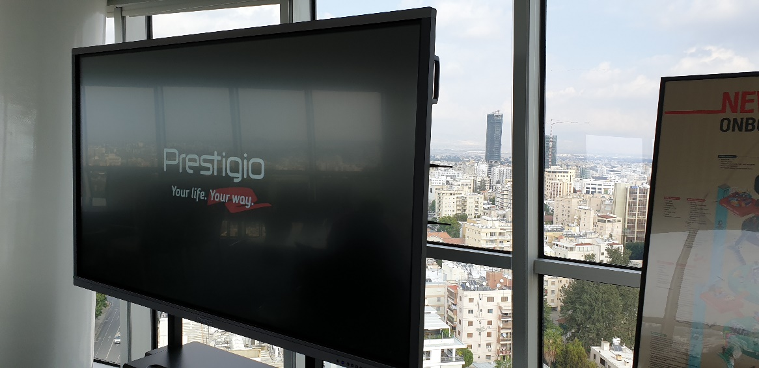
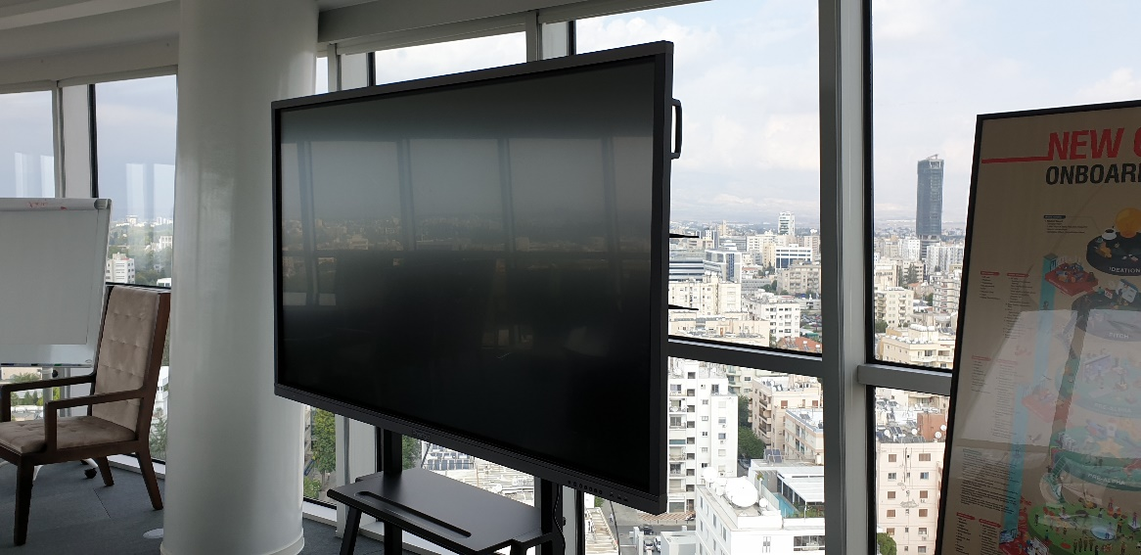
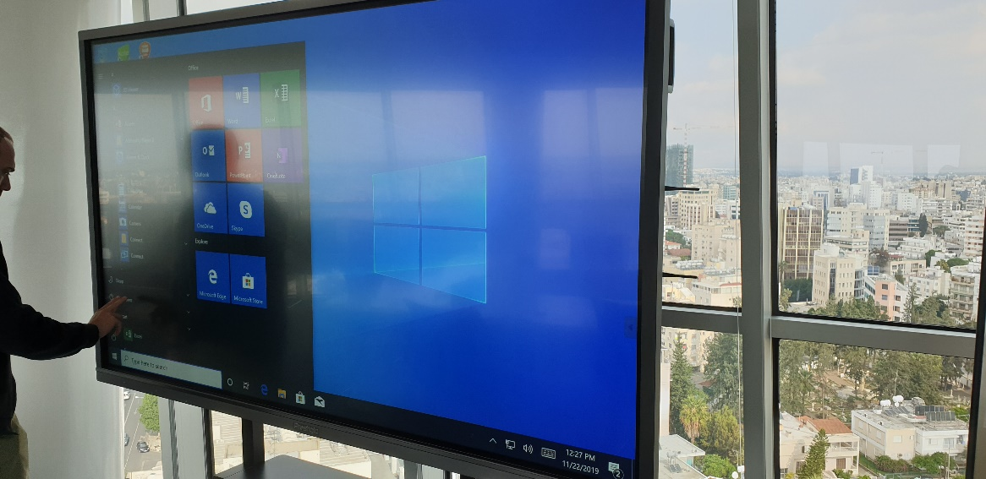
Cyprus
Solution: 55” and 86” Multiboards
Client: Wargaming Group
Business need: equipment of conference room in the office. Needed for effective presentations for employees and guests
Sales channel: directly to BEU

Slide 8
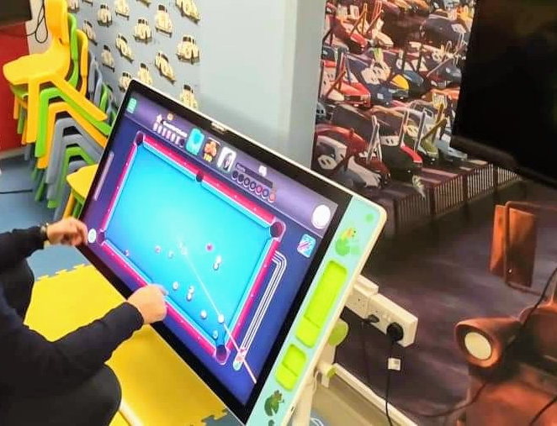
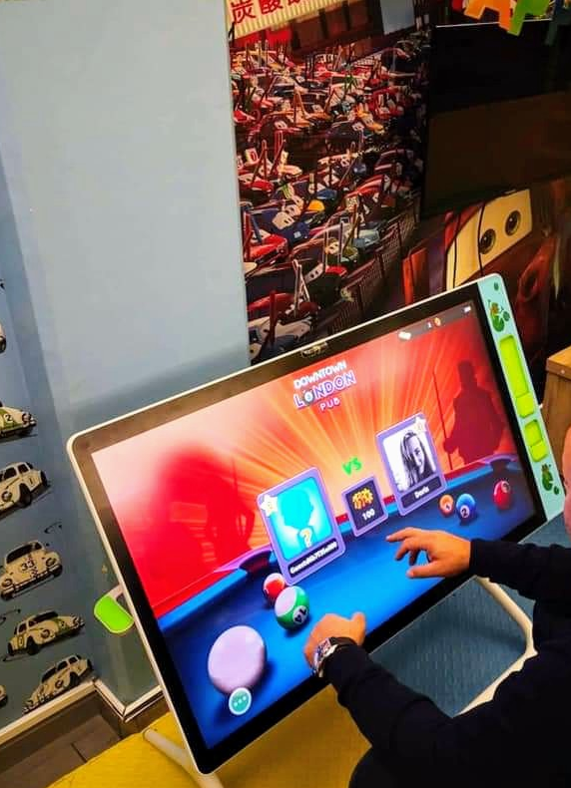
Cyprus
Solution: Prestigio Solutions Multiboard for Kids 43"
Client: PIZZA MIA
Business need: To upgrade kids' place in a restaurant
Sales channel: End Customer (BEU)
Decision maker: Owner

Slide 9
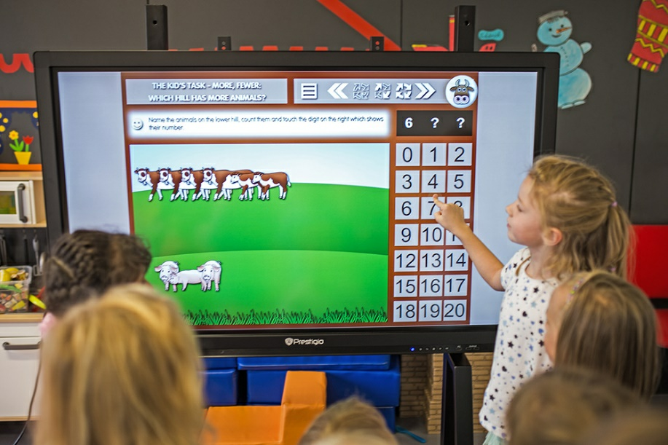
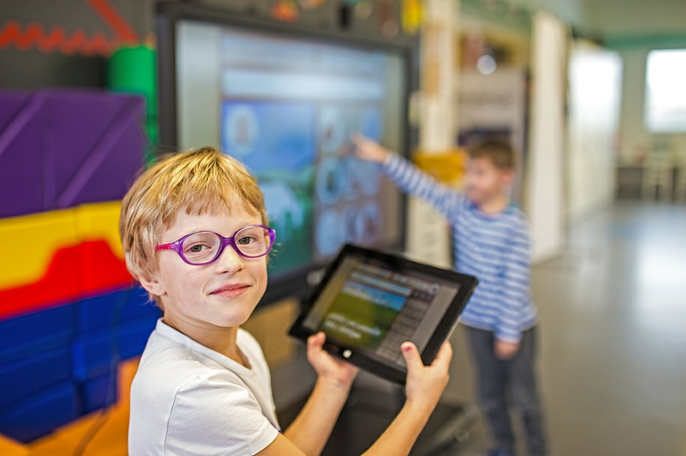
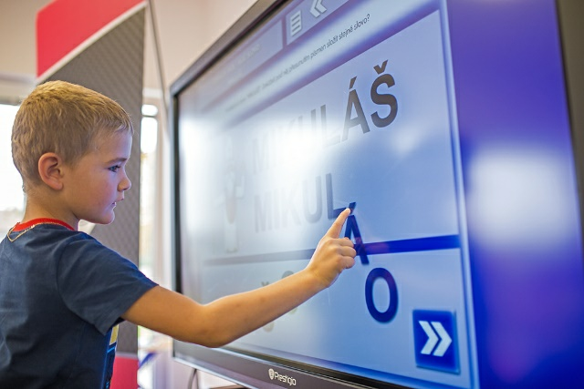
Czech
Solution: MultiBoard 55”, mClass software
Client: Elementary school in Prague

Slide 10
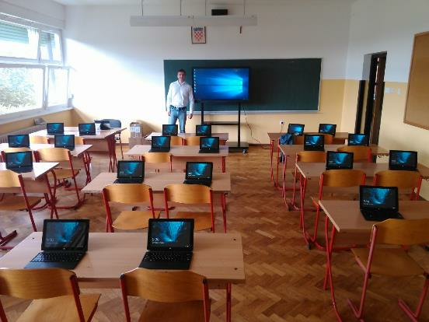
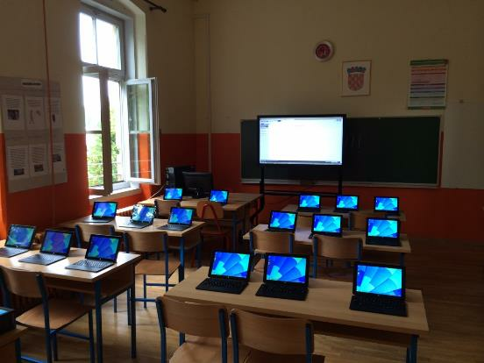
Croatia
Solution: Multiboard 55”+ mClass, 5 classrooms installed
Client: Schools in Krasic & Luka

Slide 11
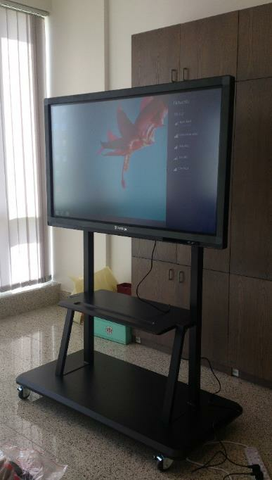
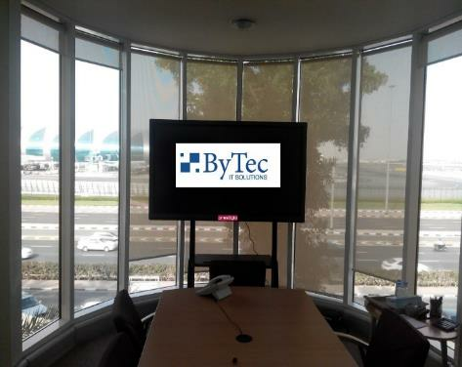
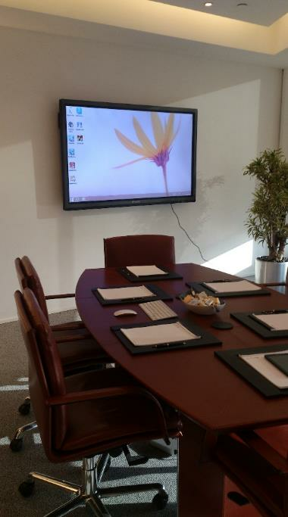
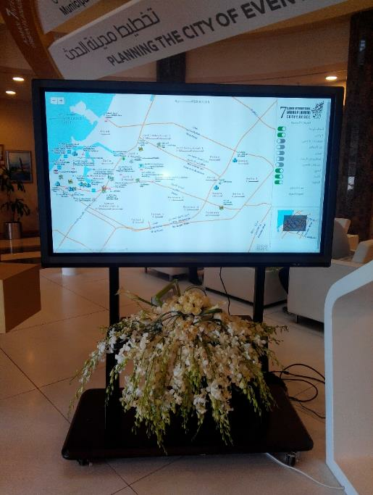
UAE
Solution: Multiboard 65”
Client: Sharjah Airport conference room.
Solution: Multiboard 65”/55”
Client: Al Ghurair and ByTec
Solution: Multiboard 65”
Client: CIB Finance Emirates Tower
Solution: Multiboard 70”
Client: Ajman Municipality

Slide 12
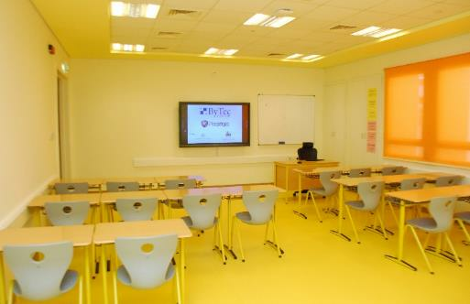
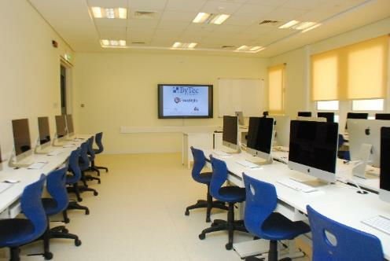
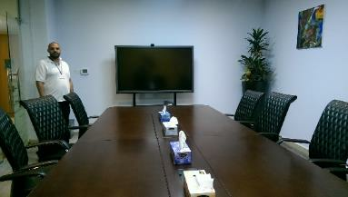
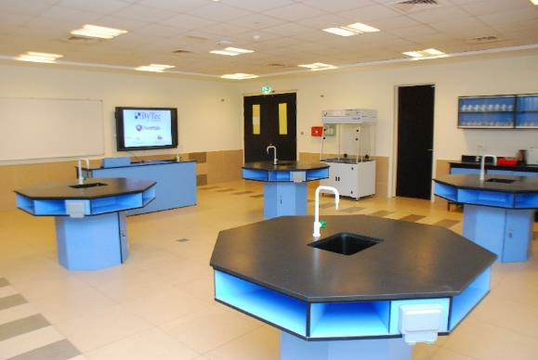
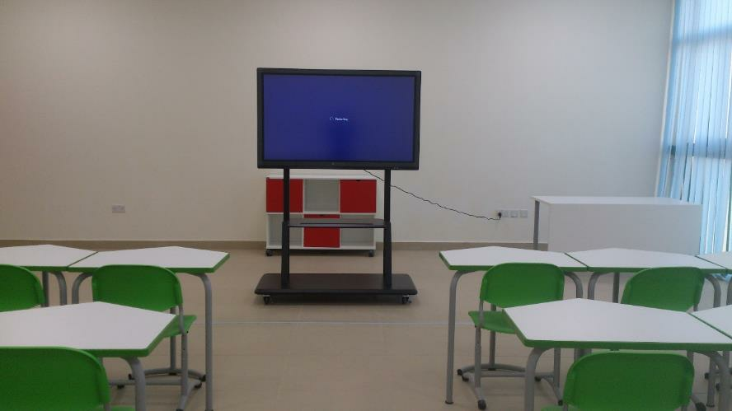
UAE
Solution: Multiboard 55”/65”
Client: Alyasat School
Solution: Multiboard 65”
Client: Emirates College for Advanced Education

Slide 13
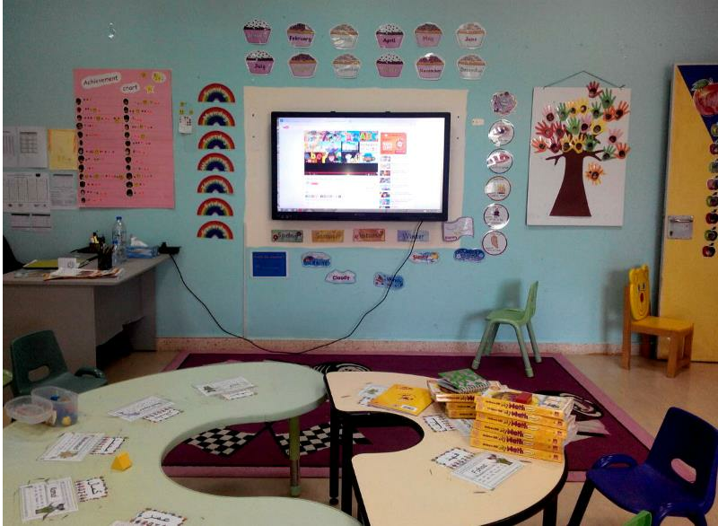
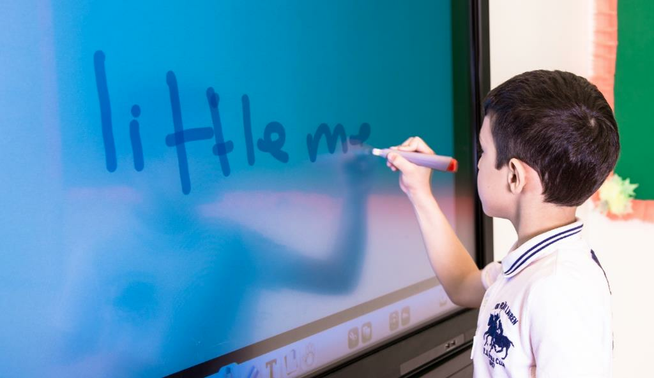
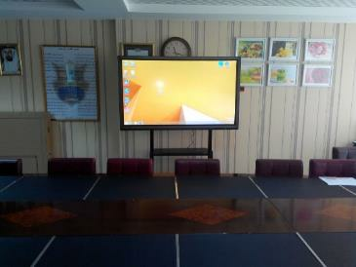
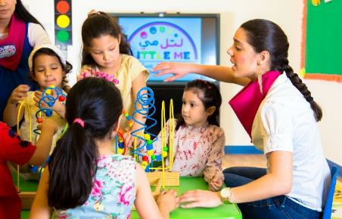
UAE and Kuwait
Solution: Multiboard 65”
Client: Al-Wahda School
Solution: Multiboard 65”
Client: Little Me School

Slide 14
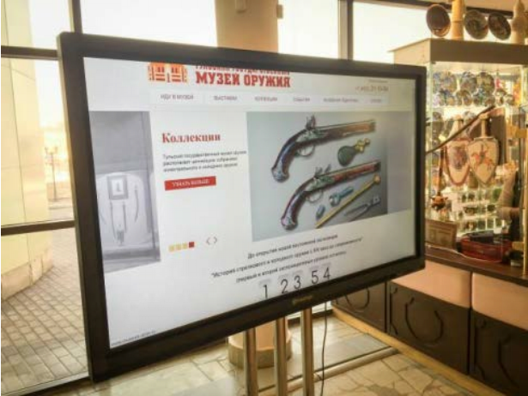
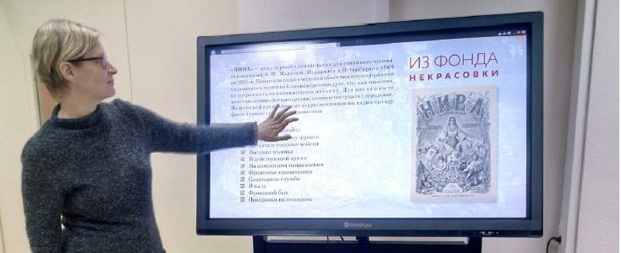
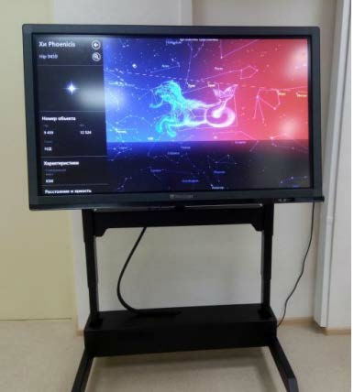
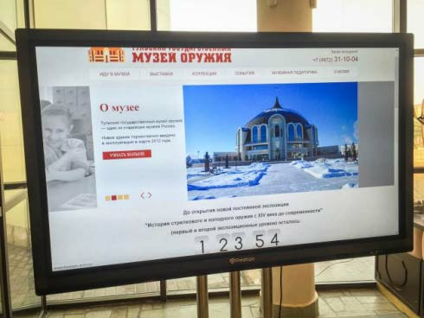
RUSSIA
Solution: Multiboard 55”
Client: Nekrasov Library in Moscow
Solution: Multiboard 70”
Client: Tula State Museum of Arms

Slide 15
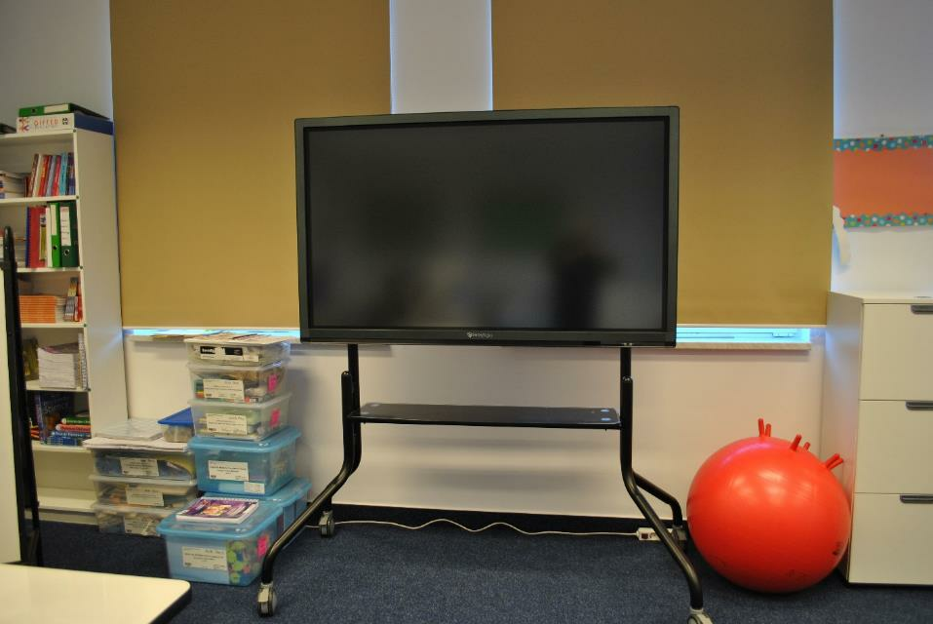
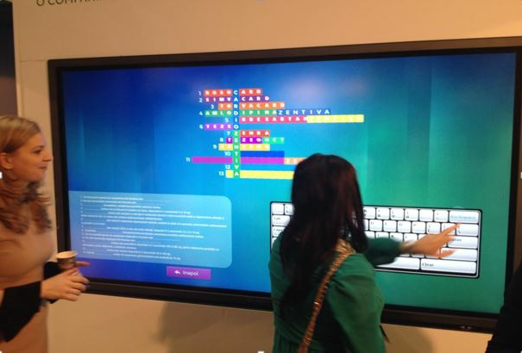
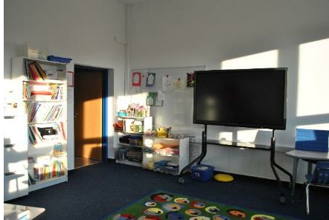
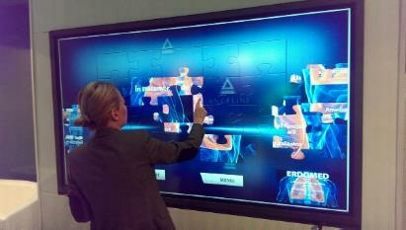
ROMANIA
Solution: Multiboard 70”
Client: American International School in Bucharest
Solution: Multiboard 70”
Client: Evolve Media, software development company

Slide 16
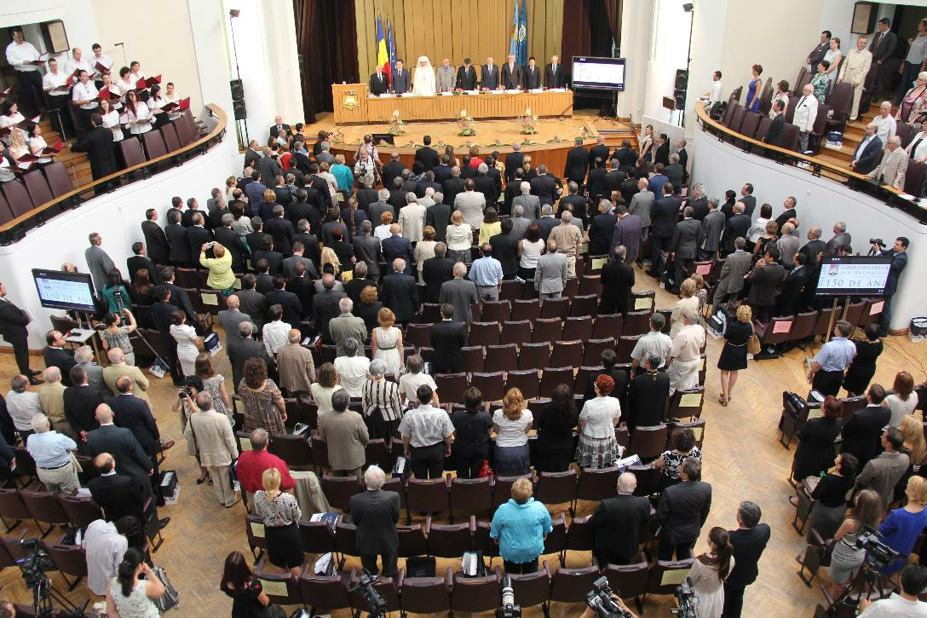
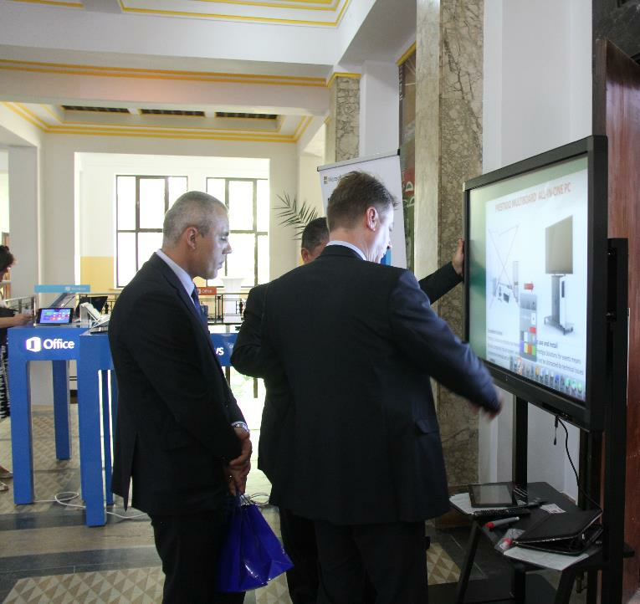
ROMANIA
Solution: Multiboard 70”
Client: Bucharest University
Solution: Multiboard 65”
Client: Promo event with Microsoft Romania

Slide 17
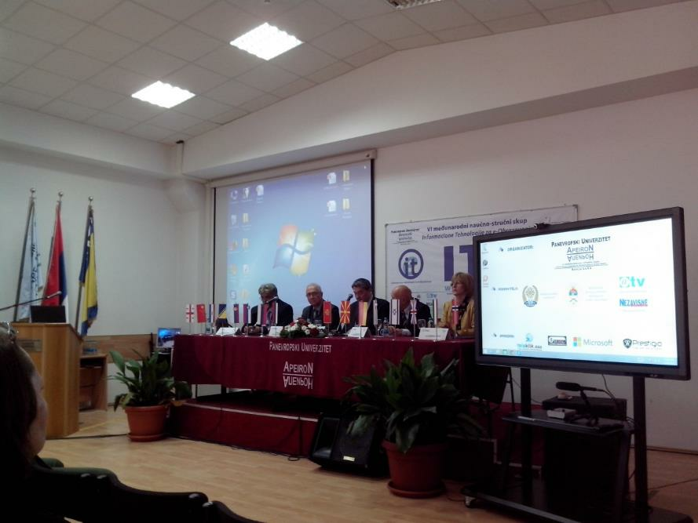
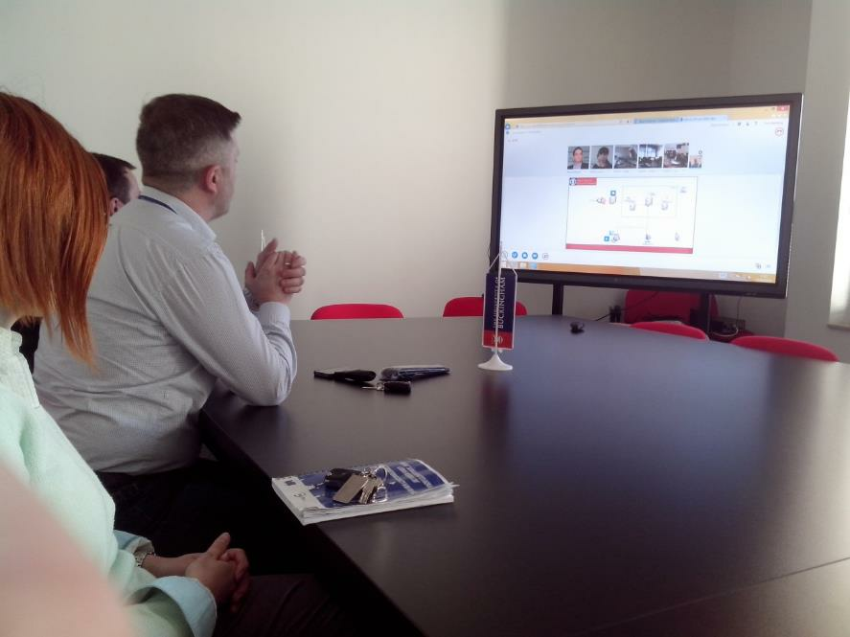
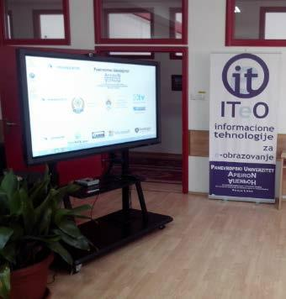
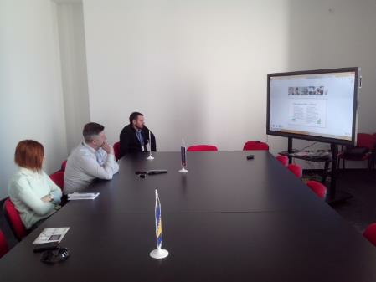
Bosnia & Hercegovina
Solution: Multiboard 70”
Client: Paneuropean APEIRON University
Solution: Multiboard 70”
Client: Sarajevo School of Science and Technology

Slide 18
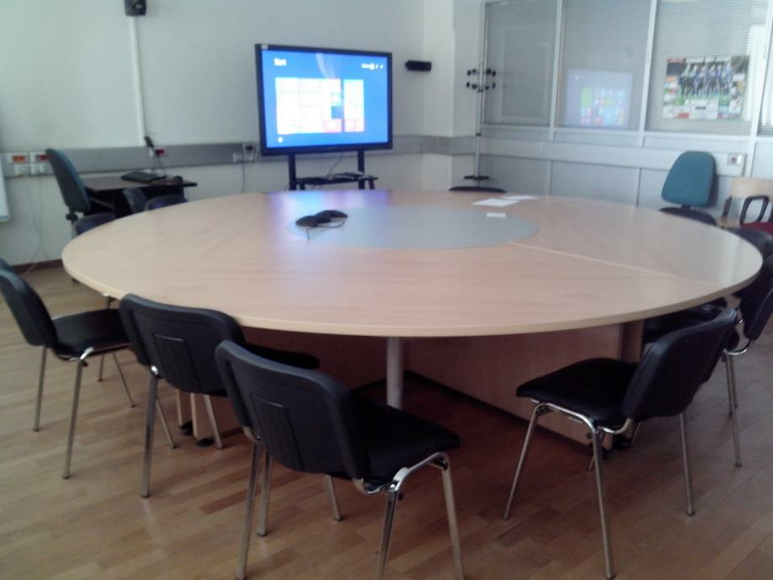

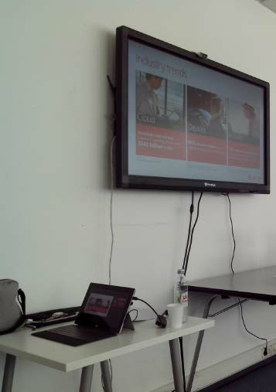
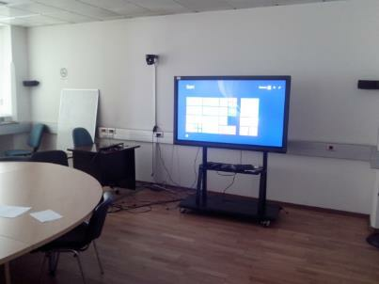
Bosnia & Hercegovina
Solution: Multiboard 55”
Client: UniCredit Bank Banja Luka
Solution: Multiboard 65”
Client: BH Telecom

Slide 19
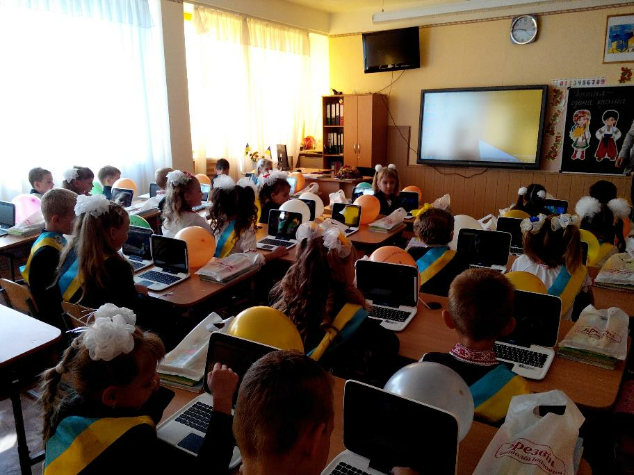


Ukraine
Solution: Multiboard 65”
Client: National University Lviv Politechnics
Solution: Multiboard 55”/65”
Client: British International School

Slide 20


Lithuania
Solution: Multiboard 65”
Client: Grigiskiu Sviesos gimnazija
Solution: Multiboard 70”
Client: Class of the Future, during Educational Fair

Slide 21



Lithuania
Solution: Multiboard 70”
Client: Lithuania Children and Youth
Center in Vilnius
Solution: Multiboard 65”
Client: The General Jonas Žemaitis Military Academy of Lithuania

Slide 22



Bulgaria
Solution: Multiboard 65”
Client: Sofia Mathematics High School
Solution: Multiboard 65”
Client: Ruse University

Slide 23







TV
Cyprus:
Multiboard 86” on Mega TV.
Bosnia:
Multiboard 65” was used by Face TV
during World Cup shows.
Ukraine:
Multiboard 65” on news Channel 24.

Slide 24




Meeting Rooms
UAE:
Ohio Trading equipped
its room for
conferences and
meetings with
Multiboard 65”.
Bosnia:
Head office in Sarajevo where one of the
55” MultiBoards is installed.

Slide 25


Ukraine
Solution: 65”Multiboard+mClass software
Client: Grand, international school, Kiev
Business need: Enhance productivity of educational process by implementing interactive classroom solution.
Sales channel: via partner

Slide 26


Georgia
Solution: 86” & 98” Prestigio Solutions Multiboards
Client: Parliament of Georgia
Business need: Internal meetings & online collaboration
Sales channel: via partner
Decision maker: n/a
Client’s feedback: coming soon

Slide 27




CAPITAL TV CYPRUS
CYPRUS POLICE

Slide 28



Latvia
Solution: 43” Prestigio Solutions Multiboards
Client: Capital Clinic Riga
Business need: to equip kids zone in the clinic
Sales channel: directly to end user
Decision maker: Director
Client’s feedback: “nice solution for the kids”

Slide 29
Your reliable partner
in solutions for business and education
Thank you!

